Slide 1
Editable Posters
Here are your customisable posters that you can use to share Qualsys’s software solution with your company, gain executive buy-in, and educate stakeholders on the system. Feel free to make changes to support accordingly.
If you’re an existing customer, you can also use this to help boost engagement with the system.

Slide 2
10
1
9
Reduce
wastage
Instantly see performance
2
Keep projects
moving
Better traceability
8
Top 10
Things
To Know
About
Using
EQMS
at
3
[insert your logo]
Full audit trail
See your responsibilities
Achieve more
Save time finding information
7
4
Works anywhere
Faster feedback
6
5
Log into EQMS today: [insert EQMS URL]

Slide 3
10
1
9
Reduce
wastage
Instantly see performance
2
Keep projects
moving
Better traceability
8
Top 10
Things
To Know
About
Using
EQMS
at
3
[insert your logo]
Full audit trail
See your responsibilities
Achieve more
Save time finding information
7
4
Works anywhere
Faster feedback
6
5
Log into EQMS today: [insert EQMS URL]

Slide 4
Log into EQMS: [insert URL]
Get the right information to the right person at the right time
For leaner, stronger, more profitable businesses

Slide 5
By [Date], [Your Company]
will be using
will be used to manage:
Critical policy and procedure documents
Issues from identification to resolution
Training and competency requirements
Supplier performance
Equipment lifecycles
Log into EQMS to get started:
[insert EQMS URL]
For leaner, stronger, more profitable businesses

Slide 6
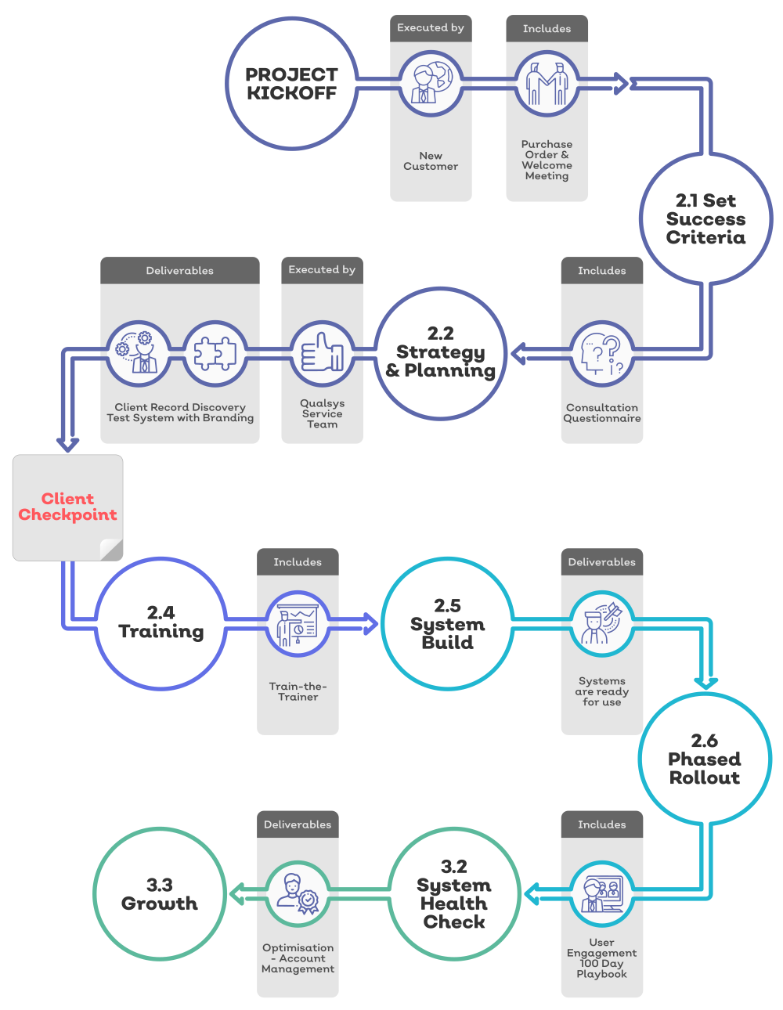
What To Expect:
Your EQMS Journey

