Slide 1
Welcome: How to use this presentation
This presentation is for raising awareness of the EQMS project early in the implementation process
Customise the slides:
Adapt with your own statistics, based on your research
Explain the benefits of the system
Get buy-in for a new project or use it to educate employees across your business.

Slide 2
We need a stronger GRC system
e.g. 87% of employees said they don’t feel confident the information they are accessing is correct.

Slide 3
“I don’t have visibility of what is happening. I need a picture of the business.” - CEO

Slide 4
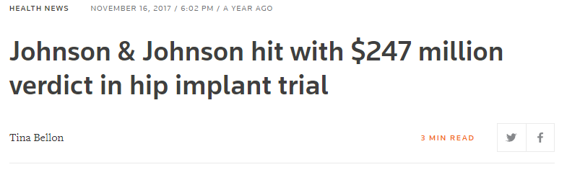
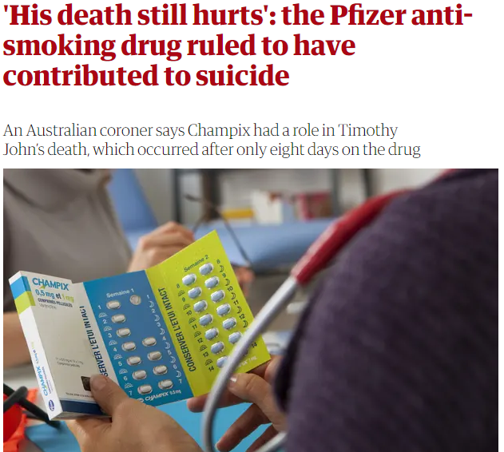
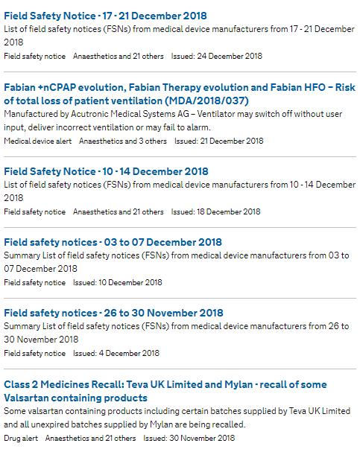
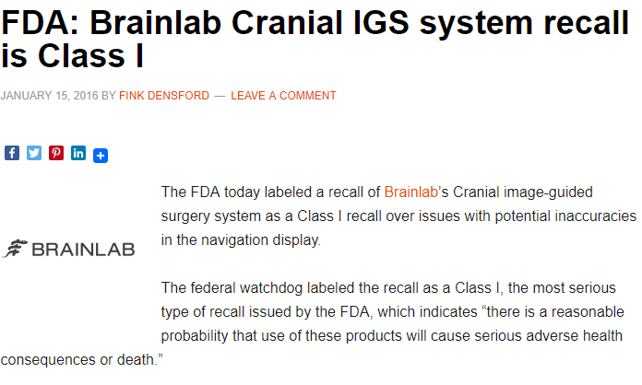
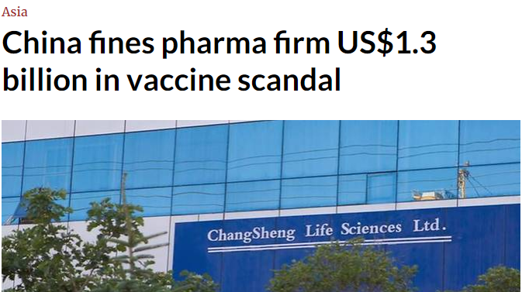
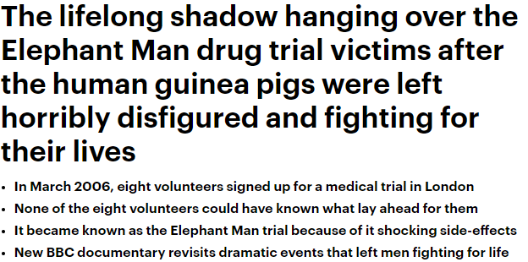
Notes:
These are just some of the examples of poor governance, risk and compliance management
e.g. pret supplier audits, facebook data breach, ethical failures etc.
We need to a robust management system for governance, risk and compliance best practice. EQMS is the essential tool we will use to embed and enforce best practices throughout the business.

Slide 5
400+ successful implementations
Notes:
Qualsys are our supplier, they have managed over 400 implementations: www.qualsys.co.uk

Slide 6
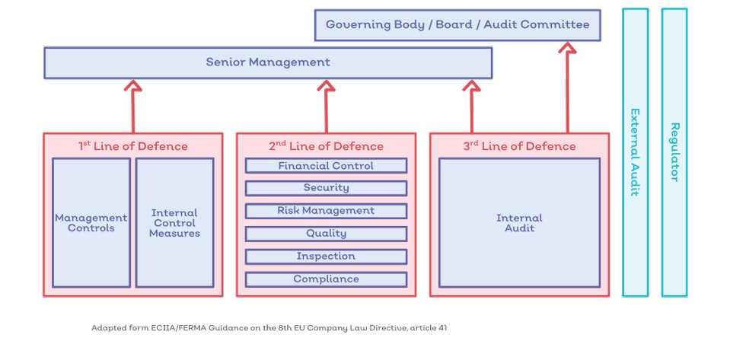
Three lines of defence
Notes:
We need leadership to buy-in to governance, risk and compliance to enable the first line of defence. Too often, organisations do the 2nd and third but not the 1st.
EQMS helps us to put in place the controls required for the three lines of defence.

Slide 7
Context
Current costs of poor quality: £XXX
Current Net Promoter Score: XX
Non-conformities last 5 years: XX
Potential fines for non-conformities: £XXX
“We can’t all access the same information.”
“Lack of interaction”
“Difficult to identify and assess risks across the business.”
“Poor communication across departments.”

Slide 8
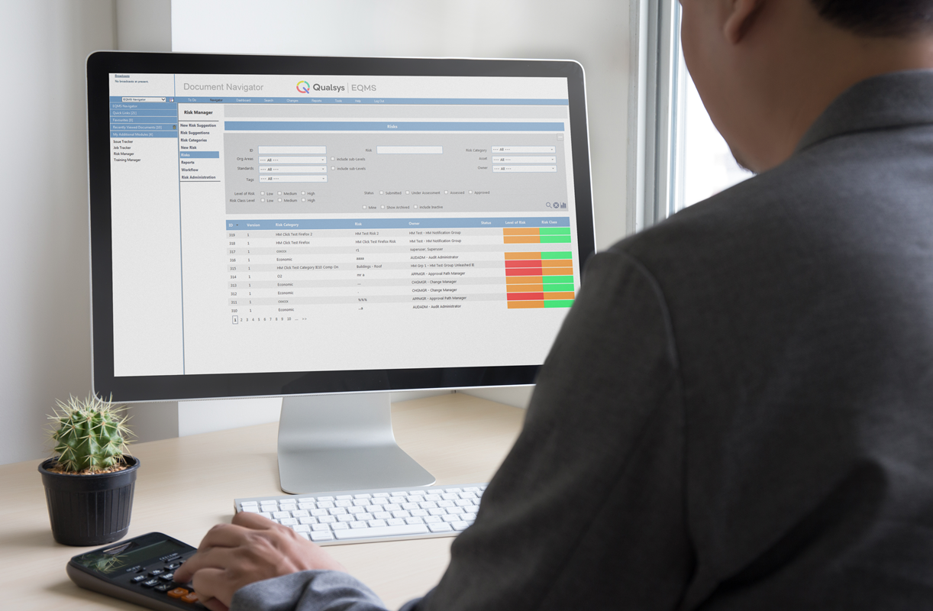
Our solution
6 month project to upgrade QHSE management system
Work in partnership with Qualsys to implement a new software system which is:
Properly configured
Easy to maintain
Scalable, meeting both our long and short term business objectives

Slide 9
The GRC vision
1. Collect risk and opportunity data
2. Audits
3. Risk treatment
Internal issues, NCRs, training
Macro-environmental changes
Inspections
Policies & documentation
Process reviews
Culture health checks
Department audits
Risk and opportunity identification
Reports
Business continuity
Workflows / CAPA
Business improvement
Notes:
Here's how our software helps:
Collect risk data using Kiosk, risk suggestions, auditing applications, issues, NCRs, CAPAs. Too many organisations expect you to simply pull this data from thin air. You need to start by collecting data from on the ground. Macroenvironmental changes – things like all of your regulatory requirements in a single system
Then you plan, schedule, undertake the audits
Then you implement the risk treatment strategy

Slide 10
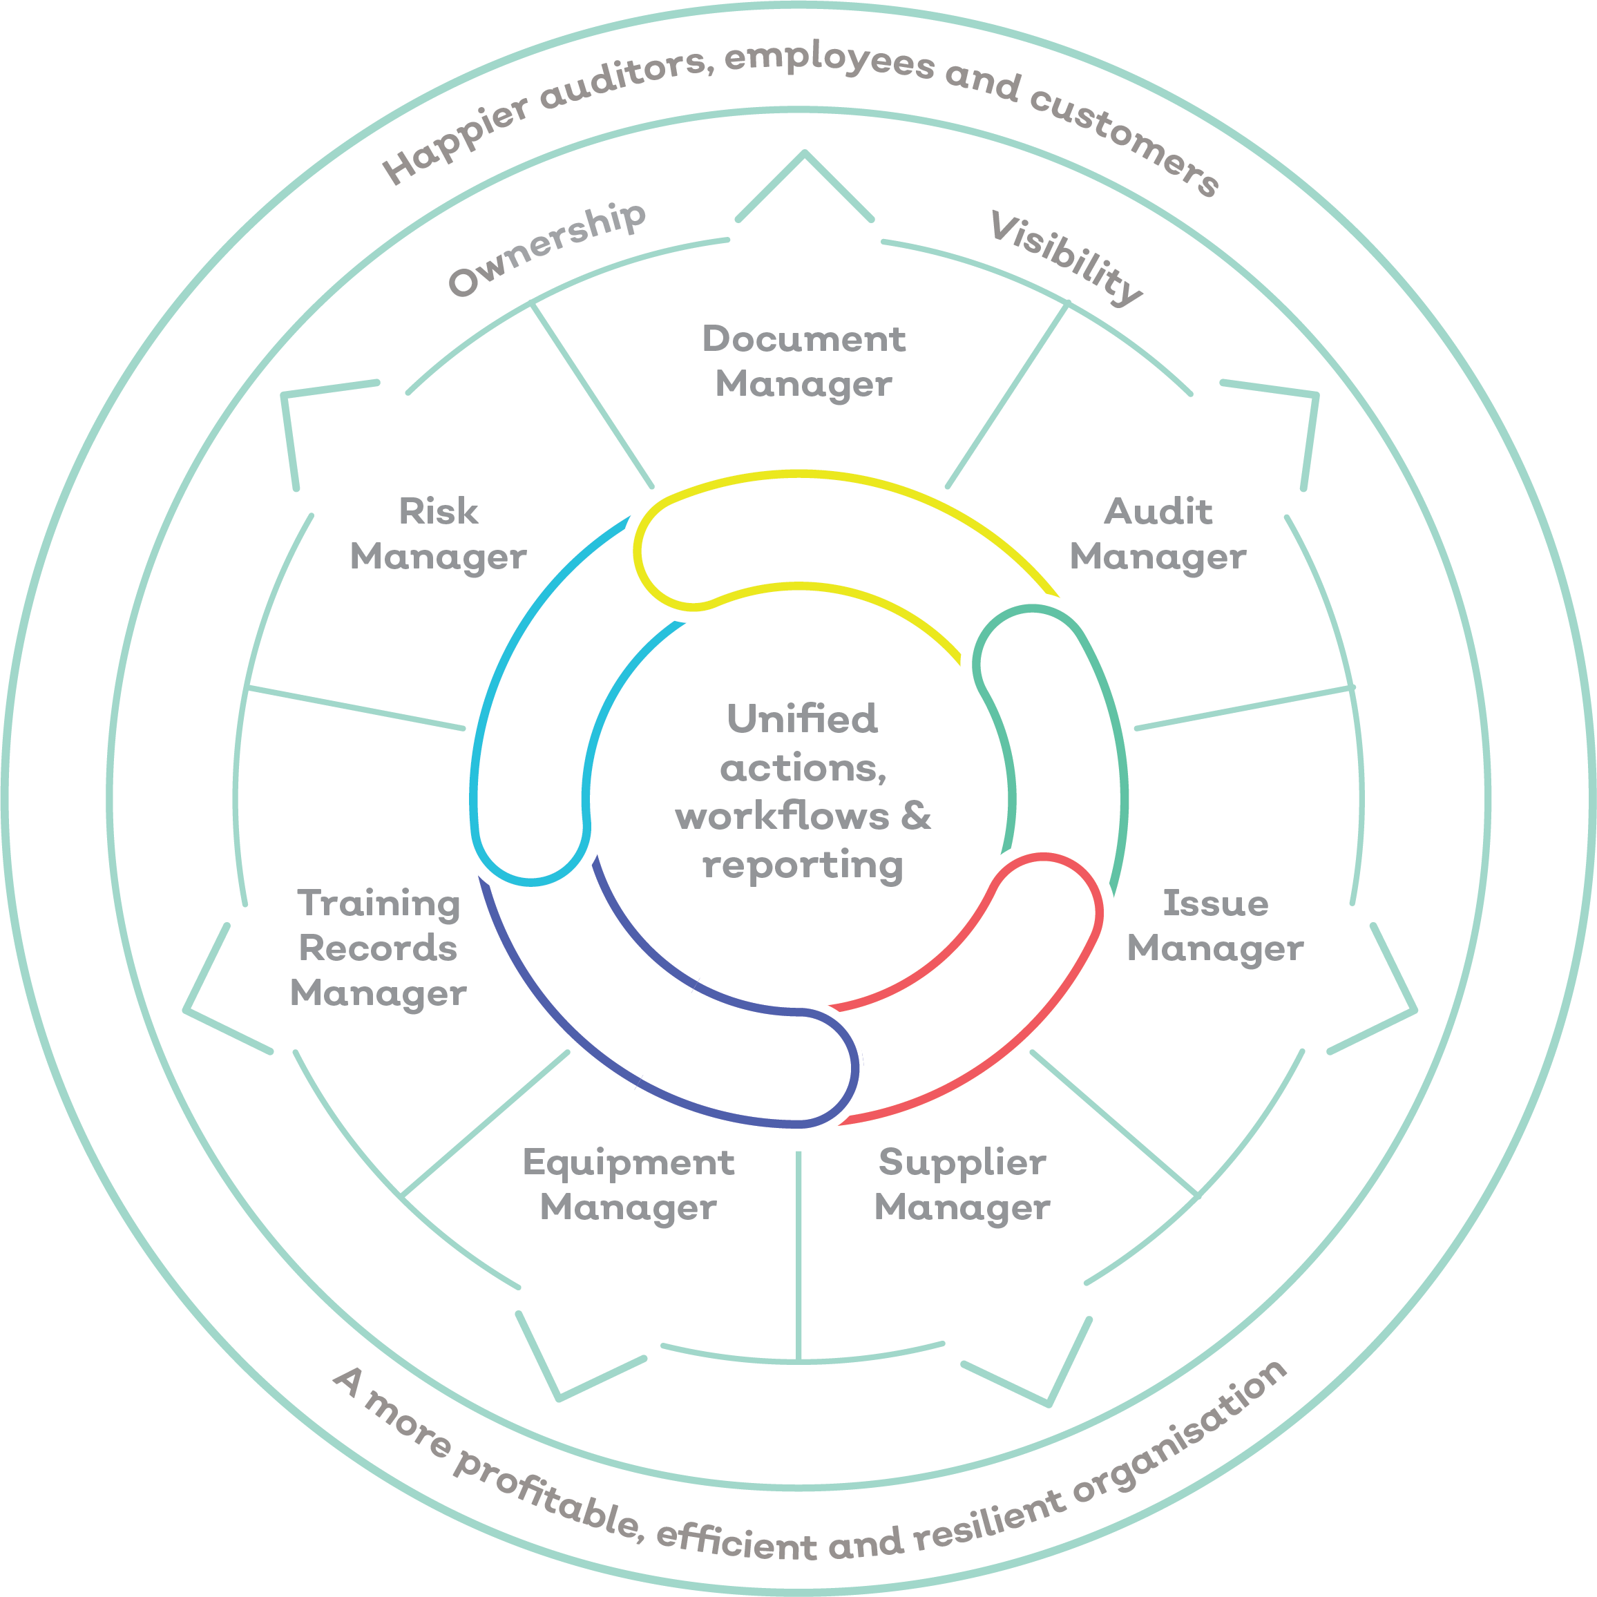
What is the solution?
Integrated modules & integrates with ERPs– no more duplication of effort or manual data exchange.
Automated workflows, audit trails and e-signatures – easy to know what and when you need to do something
User friendly interface
Web-based, hosted in ISO 27001 data centre
Instant reporting – continually monitor KPIs such as COPQ, NPS, LTV.

Slide 11
One single source of truth: 50+ ways organisations use EQMS
Comply with global regulations and standards
ISO 9001
ISO 14001
ISO 22301
ISO 37001
ISO 27001
ISO 13485
ISO 45001
ISO 28000
ISO 22000
BS ISO 10001
ISO 31000
ISO 14971
ISO 50001
Control process & apply your methodologies:
ISO 19011
ISO 41001
IATF 16949
BRC
SMETA / SEDEX
HSE
CLP
FDA
MHRA
FCA
GDPR
Modern Slavery Act
REACH /HACCP
Document control
Audit management
Incident / accident management
Supplier management / custom supplier portals
Employee competence
Risk management
Governance best practice
Inspection management
NCR / CAPA
Equipment maintenance and calibration
SOP / policy management
Customer feedback
Lean six sigma / DMAIC
8D
APQP / PPAP
Privacy by Design
BI reporting
Voice of Customer, NPS
Data and record management
War room preparation / inspection readiness
Risk register
Privacy by Design
Workflows / action based triggers
Demonstrate compliance
Notes:
EQMS evolves with your business

Slide 12
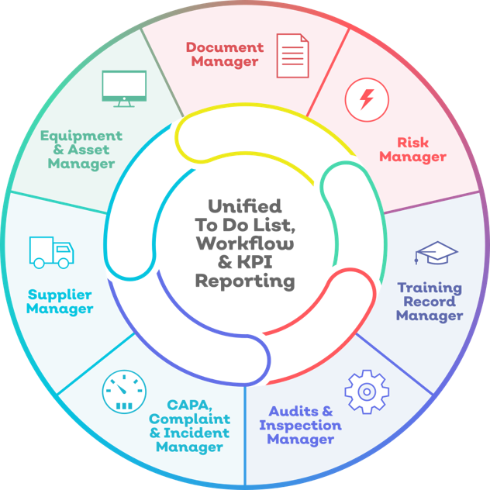
Why EQMS?
EQMS evolves with your business
Available in 15+ languages
Mobile applications
Free end users
Advanced permission controls
8 configurable modules – pick and mix what you need
Easier, faster certification to ISO standards
Quick, systematic migration of your data
Microsoft Outlook integrations
World-class best practice 1-day per module implementation process
High levels of support
Assisted validation journey – compliant with FDA / MHRA – GAMP 5 category 4 methodology
www.qualsys.co.uk

Slide 13
Understand the modules

Slide 14
Dashboard
An intelligent way to start your day
Performance Chart
Track how your organisation is performing.
Outstanding Actions
Focus on high priority issues and risks.
Integrated management
Modules integrate for a complete business solution.
Schedule reports
Management KPI reports sent directly to your inbox.

Slide 15
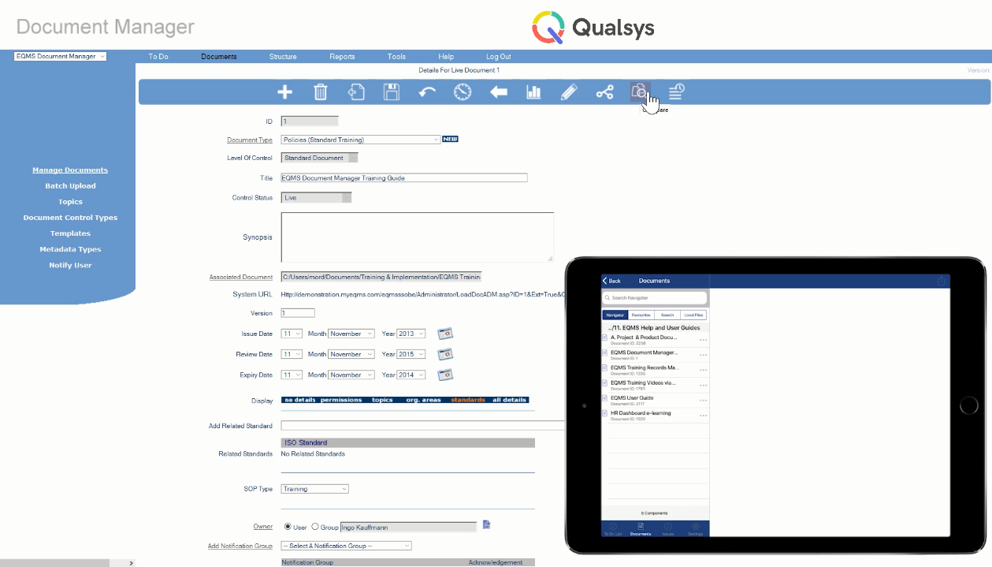
Document Manager
Find policies, plans, procedures and process information.
Single source of truth
Find the latest version of each document.
Live to-do list
Access your personalised list of actions.
Install Microsoft Add-ins
Access controlled documentation from Microsoft Outlook, or check-out documents in PowerPoint, Word and Excel.

Slide 16
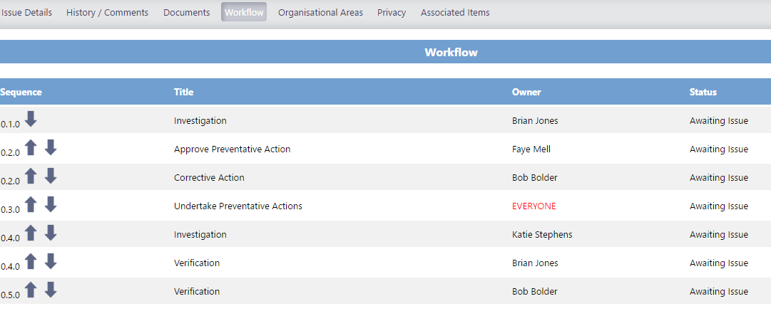
Workflows
Action-oriented processes for continuous improvement
Closed-loop processes
End-to-end issue management.
Alerts
Automatically send updates to relevant parties.
Improve accountability
No issue is ever overlooked.

Slide 17
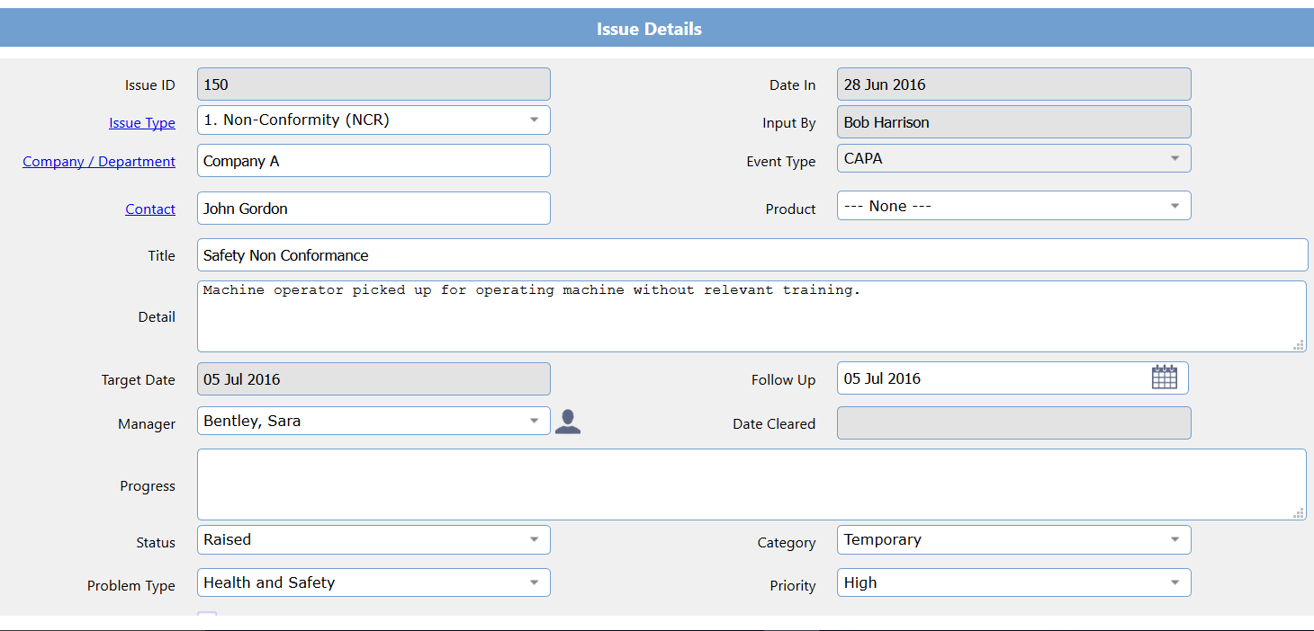
Control information
Collect useful information your organisation can use to improve
Control over fields
End-to-end issue management.
Highly configurable
All fields are dynamic based on form configuration, to meet internal and regulatory requirements.
Fool-proof
Easy to follow fields mean all data is input consistently and is straightforward.

Slide 18
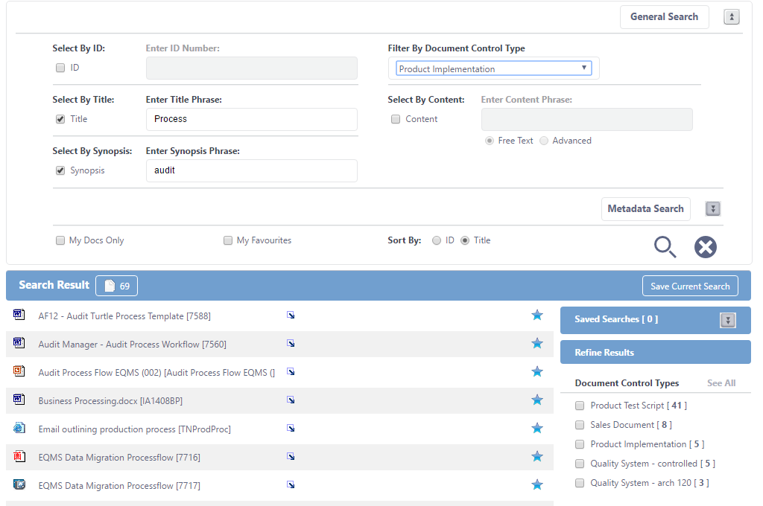
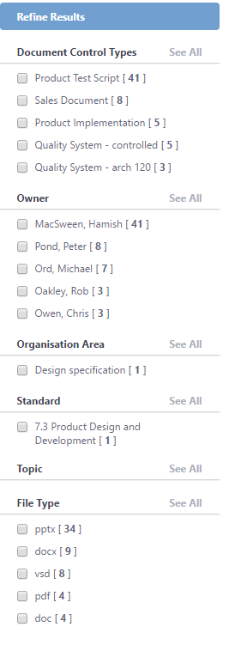
Search
Find what you are looking for fast
Refine results
Drill down to find the information you need quickly.
Save searches
Find your favourite files fast.
Eliminate silos
Get the right information to the right people.
Intelligent search engine
Based on most frequently accessed documents.

Slide 19
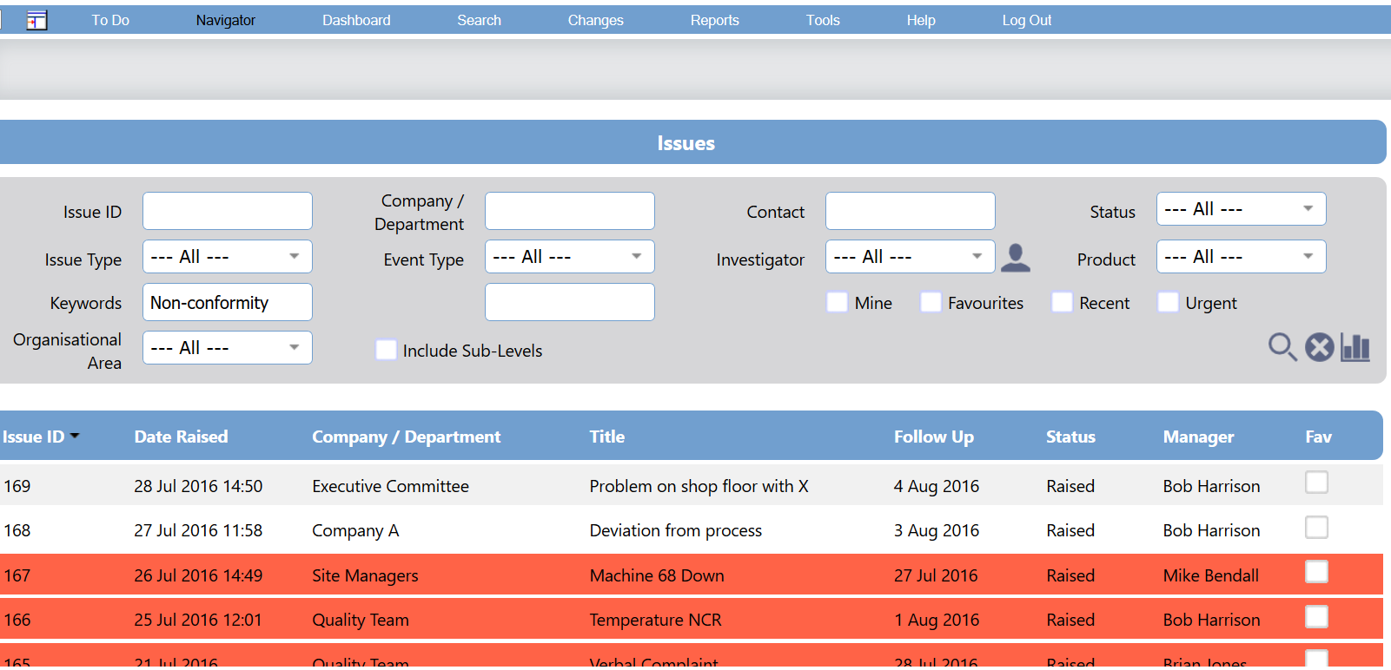
Control information
Collect useful information your organisation can use to improve
Control over fields
End-to-end issue management.
Highly configurable
All fields are configured to meet internal and regulatory requirements.
Fool-proof
Easy to follow fields mean all data is input consistently and is straightforward.

Slide 20
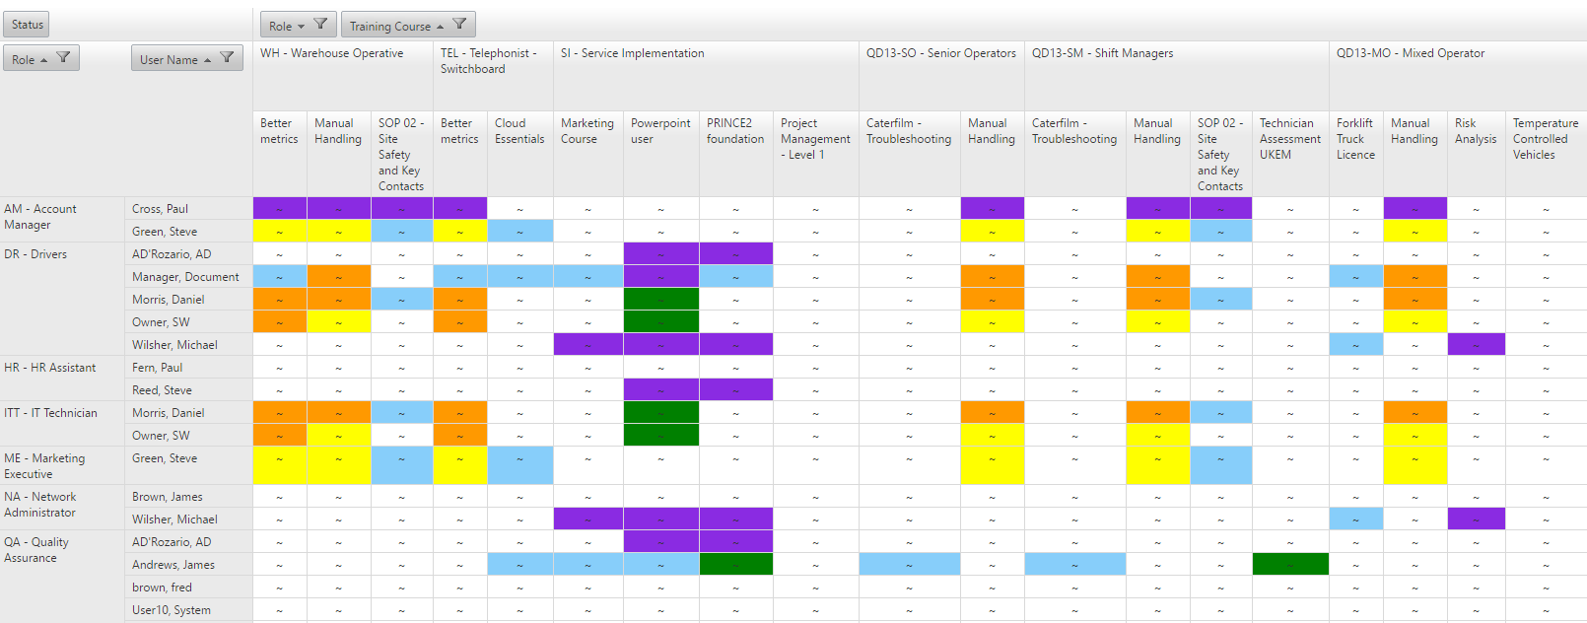
Training records
Control over all training activity in your organisation.
Built-in compliance
Plug training gaps and ensure staff have the competencies required.
Track performance
Track attendance, course feedback, trainer evaluation and training costs.
Cut administration costs
Reduce effort for managing training.

Slide 21
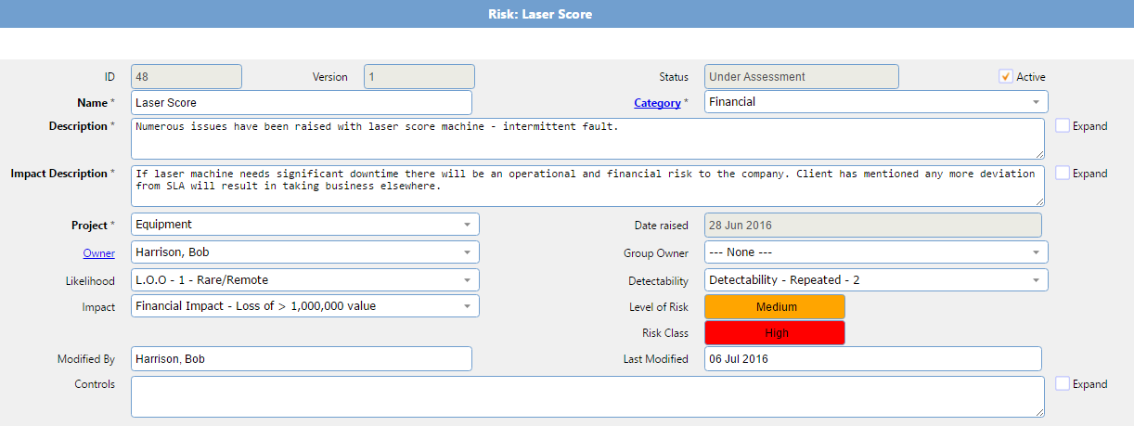
Manage Risk
Manage enterprise risk in one system.
Systematically manage risk
Assess, address, analyse and review risks.
Leadership understand risk status
Instantly view risk profile.
Drive governance
Assign responsibility to relevant personnel.

Slide 22
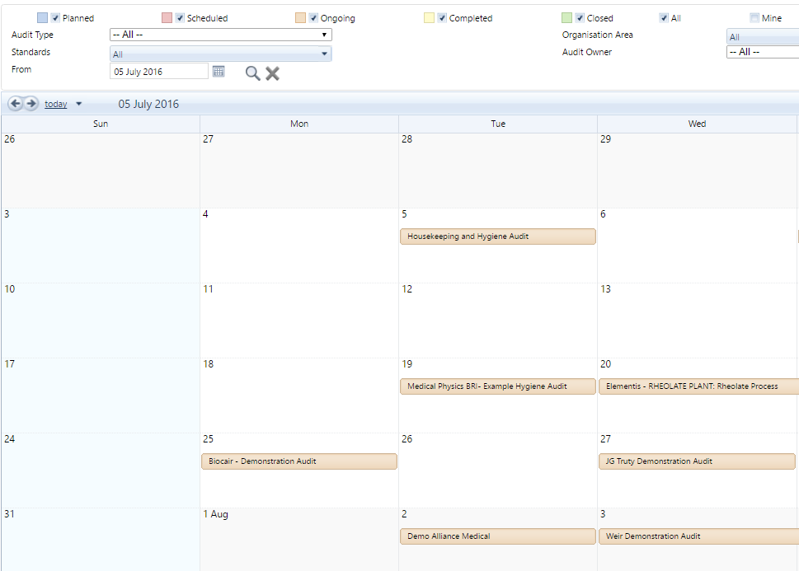
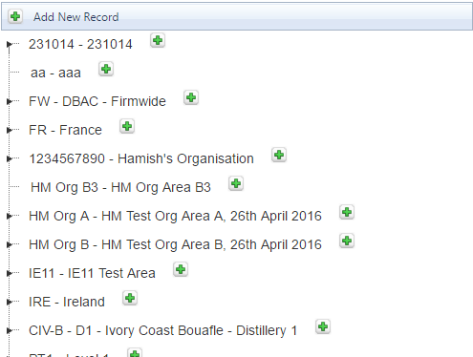
Audit Manager
Plan, schedule and manage multiple audits quickly and efficiently.
Rapidly resolve problems
Problems can not be ignored.
Assess audit results
Real-time availability of data.
Simplify audit process
Minimise effort required to co-ordinate activity across multiple standards and regulations.

Slide 23
Implementation
Transition now for sustainable, long-term results.
Experienced team
400+ EQMS implementations.
Methodological approach
Follows a ‘plan-do-check-review’ process.
Future-proof
Get control now for long-term results.

Slide 24
What to expect
Qualsys will share tasks with you using Team Work application
The go-live date is expected to be ________.
Your project manager is ________.
Your Service Implementation lead at Qualsys is _______.

Slide 25
3 things to do now:
Review your process and policies:
What are your challenges?
What are your risks?
How can we increase our ROI by finding even more ways to use EQMS?
Sign up for Qualsys newsletter:
Product, event and quality management information
https://quality.eqms.co.uk/receive-the-free-grc-newsletter
Share our ‘commitment to quality’ press release on our website
Email emily.hill@qualsys.co.uk for your EQMS announcement press release for your website

Slide 26
Questions? Talk to Qualsys sales@qualsys.co.uk

