Slide 2
Communicate and Motivate: How to Manage Change

Slide 3
70%
Of change management projects FAIL every year.
*https://www2.deloitte.com/content/dam/Deloitte/lu/Documents/public-sector/lu-demystifying-change-management.pdf
Notes:
Change management can be very small – from introducing a plastics recycle bin, for example – to entire organisation restructures.
The key problem with managing change is motivating individuals to shift their own mindset from “I’ve always done this” to “Now I do this”.

Slide 4
46%
Senior managers agree COMMUNICATION is the biggest problem.
http://rhmr.mediaroom.com/where-change-management-fails
Notes:
A lot of senior managers agree that the failure point of implementing change is communication. They agree that, no matter how comprehensive the project plan is, when it comes to communicating the change effectively, they fall down.
Nobody has ever complained of too much communication when it comes to change! Early and continuous communication is key to long-lasting change.

Slide 5
Change Challenges
Initial reluctance for people to do things differently
Not understanding WHY a change is being implemented
Denial of requirement for change
Overcoming objections is unique to each project and each organisation
Language barriers in global organisations
Managing change roll-out across multiple sites
Notes:
It is natural to resist change. Even if processes are cumbersome, people are inclined to stick with what they know because it is comfortable and not challenging.
Introducing any change requires a challenge to individual behaviour. Motivation needs to be on a personal level – staff need to understand WHY a change is implemented in order to connect emotionally with it and progress to taking on the change themselves.

Slide 6
Change and The Grief Cycle
Notes:
A classic grief cycle can be applied to change management, too. People will experience each of the above emotions when facing change, and it’s imperative that you implement a communications strategy at each stage of this cycle to address your change process and win hearts and minds.

Slide 7
Use the grief cycle to your advantage
Shock and Denial:
Anger:
Bargaining:
Depression:
Acceptance:
Prevent resistance by communicating change as early as possible
Use strong emotion to motivate – offset anger at change by introducing benefits to individuals of using EQMS
Use the ‘Why’ of EQMS
Use the downtime to continue training sessions and keep EQMS awareness raised
Find your early EQMS champions and get them to encourage others still in the earlier stages to understand how the software will improve their lives
Notes:
Shock: Introduce the idea of the change before it is implemented. Adopt an open and communicative approach from the first step.
Anger: Discover the common resistance points – do people feel the change is not needed? Explain why it is. Do they feel it will add to their time? Explain how it will save them time.
Bargaining: Social proof is a great tool here. Demonstrate how your EQMS system will benefit them PERSONALLY – not the business, but their own working life. Will it save them time? Will overworked teams finally be able to get home on time to do the school run? Are people who champion the project more likely to be considered for promotion?
Depression: Win hearts and minds at this stage by introducing training. Deliver training on a basic level to begin with, then identify users who may need further support or more in-depth training. Once people have a real-world understanding of the new EQMS system, they are more likely to understand the WHY, as well as the HOW.
Acceptance: The people who take on training quickly and become champions of the project are your secret weapon. Use these early adopters to champion your EQMS system to their peers, as word-of-mouth and peer encouragement is one of the strongest motivators for change.

Slide 8
STOP THE RUMOUR MILL
As soon as people get wind of change, the rumours start and resentment sets in (“Why weren’t we told? How will it affect our jobs? Why should we change if they don’t want to include us?” etc).
Early communication of plans for change must include ALL stakeholders.
Notes:
A rumour starts in a grain of truth but quickly builds into a tumbling rock, like the one you’d find in an Indiana Jones action sequence.
It’s natural for people to gossip, especially when they only have half information and speculation becomes gospel. Dispell rumours at source, and if you find particular individuals are more powerful at communicating to others (i.e., they are the ones perpetuating the rumours), turn them into your allies by incorporating them early into a project – they’ll naturally spread the positive word about EQMS!

Slide 9
Understand the ‘Why?’
Without understanding the one key concept that drives people in your organisation, your change project will fail.
Win hearts and minds by appealing to:
A sense of pride in their work/the company (more efficient, better output with EQMS)
An improvement in work/life balance (due to time savings made via EQMS)
Possibility of promotion (more efficient with EQMS = business growth)
Sense of being listened to (EQMS allows for feedback)
Notes:
There is no point explaining the HOW until people get the WHY. If there is no apparent reason for change, there is no motivation to behave any differently than before. As soon as the benefits to the individual are clear, you’ll experience a more motivated mindset from your staff and EQMS will become integrated into daily tasks with ease.

Slide 10
Plan – Do – Check – Act
PLAN: Lay out a clear strategy and inform key stakeholders early on
DO: Implement your communications strategy
CHECK: Follow up with employees that
they understand why, how, and
what is changing
ACT: Identify gaps in employee understanding and address with further communications
Notes:
(Note: Animated slide. For full clarity, view in Preview mode).

Slide 11
Plan
Identify all stakeholders from directors through to end users
Plan channels of communication to use – email, posters, intranet etc
Consider phases of communication: who needs to know what, when?
Early communication to end users essential for easy adoption
Notes:
A thorough communications plan from the first stage of change is essential to successful change management.
Identify who, what, and when as you manage the EQMS implementation timeline. Remember to use different types of communication to build awareness and remind people to change habits (once EQMS is in use) – email, posters, intranet, toolbox talks etc.

Slide 12
DO
Tell everyone! Remember to explain:
WHY your EQMS system will help THEM (less admin, more time on core tasks)
WHY your EQMS system will help THE BUSINESS (ISO 9001 accreditation, business growth)
WHAT your challenges are and how EQMS solves them (unique business challenges you face)
HOW training for EQMS will be delivered (in groups? E-learning? From super users?)

Slide 13
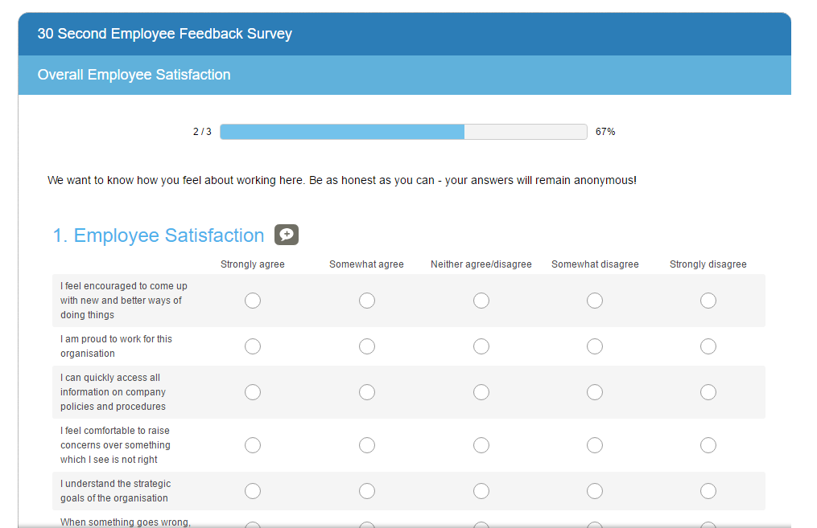
CHECK
Run an employee survey to check where understanding about EQMS currently lies
Notes:
Qualsys has a series of employee and manager feedback surveys available for customers to use. Please get in touch with us at annie.grace@qualsys.co.uk to request one.
Employee feedback surveys are ideally delivered at three stages: before implementation, during or just post-implementation, and 3-6 months after EQMS is fully in use. Using the same survey each time gives easy comparison opportunities between data sets to see how employee engagement changes over time.

Slide 14
ACT
Use feedback from survey and other contact points (emails, suggestions box, verbal recommendations) to address knowledge gaps or common problems
Return to PLAN stage
Repeat the cycle until success!
Notes:
Be proactive – monitor results of surveys, listen to employee feedback, host user group Q&A sessions. Continuous analysis allows you to identify knowledge gaps or user sticking points, and you can use this information to improve user engagement. Maybe you need more training on a particular module, or a clear training process for new starters, or perhaps your staff need to understand the WHY more clearly in order to make EQMS a habit rather than a chore. Whatever you find during the CHECK stage, act on it by planning your next phase of communications… and repeating the PLAN DO CHECK ACT cycle until satisfied!

Slide 15
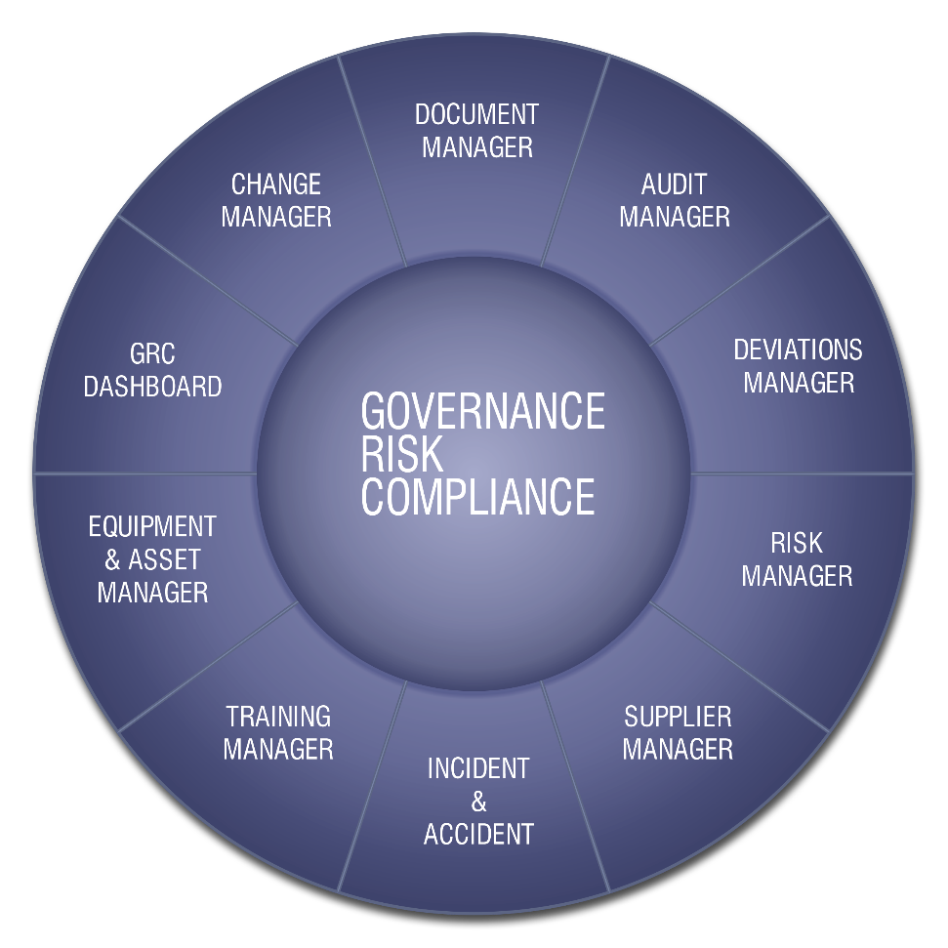
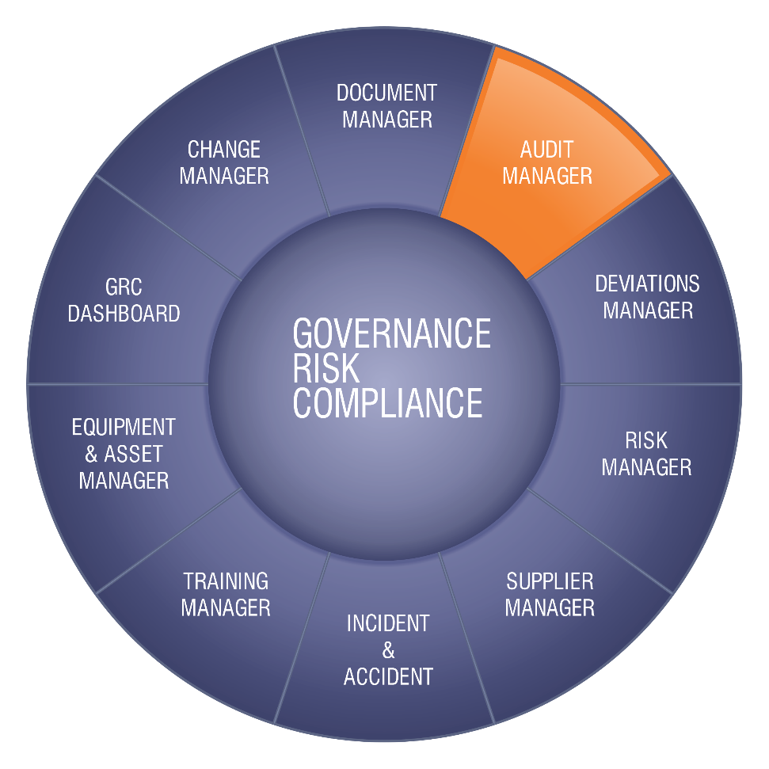
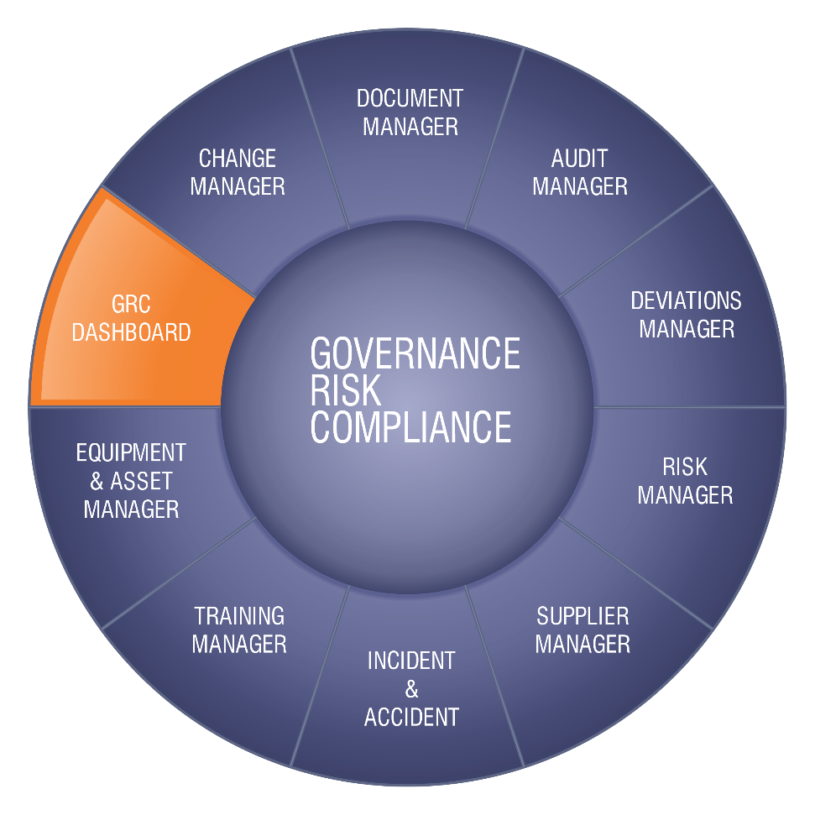
EQMS integrated Solution
Deliver and manage positive changes with EQMS
Notes:
Having an integrated EQMS system will benefit your business and your staff in many ways. Positive change management can be achieved by using the above steps, and demonstrating to employees HOW and WHY EQMS will deliver benefit to them: align the change with positive benefits from the start and you’ll experience a much greater uptake of use from the start!

Slide 16
Further Help & Support
Email: info@qualsys.co.uk
Tel: +44 (0) 114 282 3338
Fax: +44 (0) 114 282 3150
Web: www.eqms.co.uk
Qualsys Ltd
Aizlewood’s Mill,
Nursery Street,
Sheffield
S3 8GG, UK

